Slide 1

Hiring Process Analytics
By Sheevam Chakraborty

Slide 2
Description:
My task as a data analyst at a global corporation like Google is to analyze hiring process data to extract insightful information. Understanding trends such as job types, vacancies, interviews, and rejections is the main goal.
Equipped with a dataset of previous recruits, my job is to address relevant inquiries meant to improve the hiring procedure and general productivity of the business.

Slide 3
Approach and Tech Stack Used
1. Data Import and Cleaning in Excel: Import the hiring dataset into Excel. Cleanse and preprocess data, handling any missing values or inconsistencies.
2. Descriptive Statistics in Excel: To understand important metrics such as the typical number of denials, interviews, and job kinds, using Excel's descriptive statistics functions.
3. Excel Data Visualization: Make charts and graphs to illustrate patterns in job types, interviews, and rejections.
4. Excel Scenario Testing: Using basic statistical tests to evaluate significant differences, such as gaps in interview success rates between job kinds.
5. Correlation Analysis in Excel: To find relationships between variables, such as the correlation between the quantity of interviews and job openings, using Excel for basic correlation analysis.
6. Insight Interpretation and Reporting: Utilize the analytics to extract useful insights.

Slide 4
Insights
Data Analytics Tasks

Slide 5
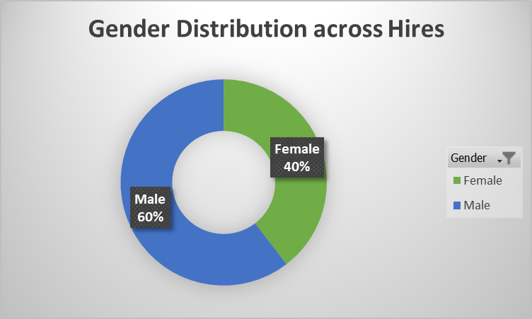
A. Hiring Analysis: The hiring process involves bringing new individuals into the organization for various roles.
Your Task: Determine the gender distribution of hires. How many males and females have been hired by the company?
Males Hired:
4083
Females Hired:
2675

Slide 6
B. Salary Analysis: The average salary is calculated by adding up the salaries of a group of employees and then dividing the total by the number of employees.
Your Task: What is the average salary offered by this company? Use Excel functions to calculate this.
Average Salary Offered:
49986.07

Slide 7
C. Salary Distribution: Class intervals represent ranges of values, in this case, salary ranges. The class interval is the difference between the upper and lower limits of a class.
Your Task: Create class intervals for the salaries in the company. This will help you understand the salary distribution
Most of the employees are clustered around the salary range of:
40,000 – 60,000

Slide 8
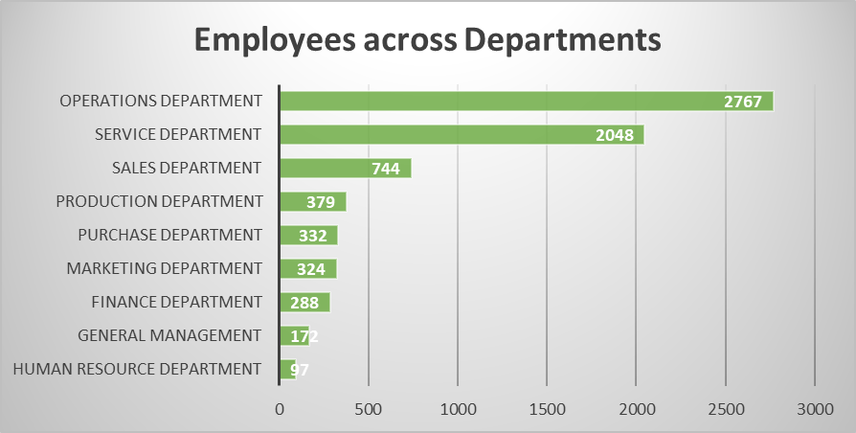
D. Departmental Analysis: Visualizing data through charts and plots is a crucial part of data analysis.
Your Task: Use a pie chart, bar graph, or any other suitable visualization to show the proportion of people working in different departments.
Majority of Employees work in Operations Department:
39%

Slide 9
E. Position Tier Analysis: Different positions within a company often have different tiers or levels.
Your Task: Use a chart or graph to represent the different position tiers within the company. This will help you understand the distribution of positions across different tiers.
Major tiers housing the maximum no. of employees:
C9
C5

Slide 10
Results
A very small but effective project to understand the metrics related to Hiring Process.
Did my best to implement the concepts of Statistics and Excel in deriving the insights.
This has helped me to put my learning into practical implementation, thus solidifying it in doing so.
I enjoyed myself playing with pivots, charts and excel overall.

Slide 11
Link or Reference
Excel Workbook

Slide 12
Thank you!

